Slide 1
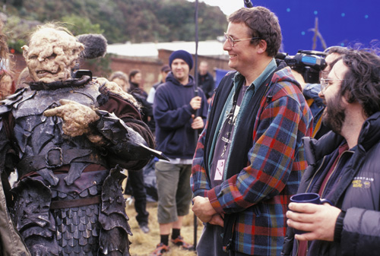
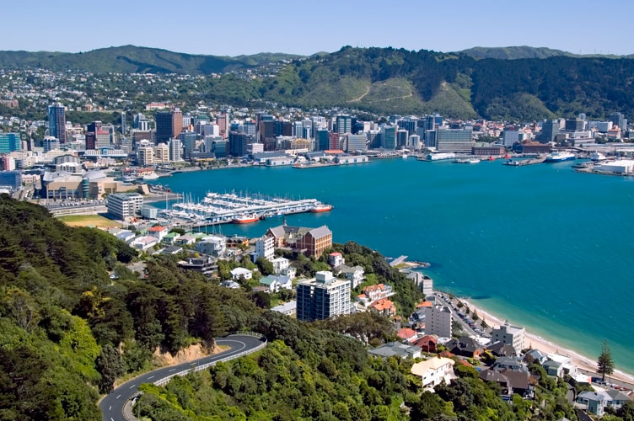
Government
Industry
Community
Academic
Wellington – New Zealand’s Capital City
Population: 389,700
"coolest little capital in the world” – Lonely Planet
Chris Jackson
Lecturer: Industrial Design
Massey University
c.jackson@massey.ac.nz

